Slide 1
Agile Software Development Teams
Extreme Programming is Key
Mark Windholtz
ObjectWind Software Ltd

Slide 2
Who Am I
Mark Windholtz
ObjectWind Software Ltd
14 years Building Professional Software
Business, Medical, Engineering, Military
First contact with XP in Oct 1996
Consulted in XP practices for 10 teams
Lead 4 teams using full XP practices

Slide 3
Agenda - 1
A Better Metaphor
XP Core Practices
The Facts of Pairing
Scheduling Features
Measuring Progress

Slide 4
What we would like to have
Requirements
Some Process
Software

Slide 5


Metaphor: Software Manufacturing
The Naïve Metaphor
Iron
Some Process
Model-T
One-time fixed deliverable
Known quantity

Slide 6
What we really need then …
Frozen
Requirements
Finished
Software
Some Process
One-time fixed deliverable
Known quantity

Slide 7
What's wrong with that?
Frozen
Requirements
Finished
Software
Requirements are never frozen.
Successful S/W is never done.
Only Failed S/W is ever finished.

Slide 8


These Things Do Not Exist
Finished
Software
Frozen
Requirements

Slide 9
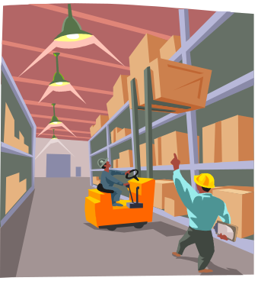

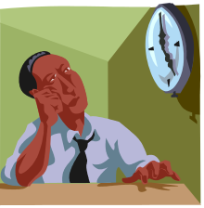


Metaphor: Software Supply Line
UML
Manufacture
the Requirements
Analysis
Design Warehouse
Coding
Deployment
Unimplemented Design is like Inventory
  Long delivery cycles
  Reduced response time
  Its all or nothing
  Warehouse a design til everything is ready

Slide 10

“Just In Time” Software
Ship early and often
Stay Agile: Implement and change designs
Eliminate the Design Warehouse
Tested and Running code all the time
Release every 4 weeks
Iteration #1
Iteration #2
Manufacture the
Requirements
Iteration # N

Slide 11
Management Benefits of Agility
Management will …
  Get an Overall release plan
    What, when, and how much
  Most value out of each work week
  See progress: code running repeatable tests
  Able to Change direction as business changes
  Be informed early of schedule changes

Slide 12
Programmer Benefits of Agility
Programmers will …
  Be told what is needed in priority order
  Allowed to produce quality work
  Able to ask for help
  Allowed to make and update estimates
  Accept responsibilities instead of assigned tasks.

Slide 13
Agenda -2
A Better Metaphor
XP Core Practices
The Facts of Pairing
Scheduling Features
Measuring Progress

Slide 14
Core Practices of XP
Programming
  Test-First
  Simple Design
  Coding Standard
  Refactoring
Customer
  Small Releases
  Planning Game *
  On-site Customer
Team
  Pair Programming*
  System of Names
  Collective Ownership
  Continuous Integration
  Sustainable Pace
  Open Workspace
* Covered in this presentation

Slide 15
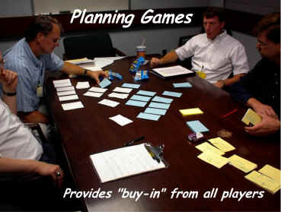
The Planning Game
Biz
  Scope
  Priority
  Features per Release
  Date of Release
Tech
  Estimates
  Consequences
  Process
  Detailed Schedule

Slide 16
Agenda - 3
A Better Metaphor
XP Core Practices
The Facts of Pairing
Scheduling Features
Measuring Progress

Slide 17
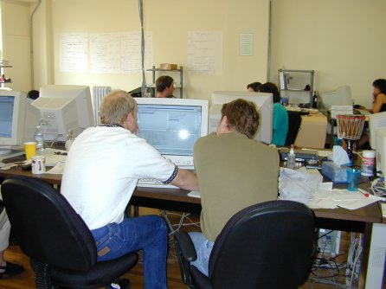
Pair Programming
Code review is good,
So review all code as it is typed in
One person types (tactical)
One person thinks (strategic)

Slide 18
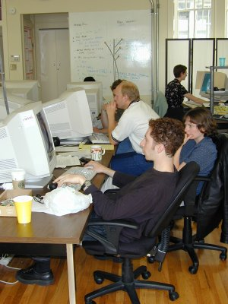
Pair Programming Photos

Slide 19
Pair Programming Facts
15% more time (Not Double)
Code 15% fewer defects
10-20% less code (less to maintain)
Source:
  The Costs and Benefits of Pair Programming.
    By Alistair Cockburn & Laurie Williams
  http://collaboration.csc.ncsu.edu/laurie
  Laurie Williams, North Carolina State University

Slide 20
Pair Economics Example
50,000 LOC Program at 50 LOC/hour.
Team of Individuals
  Time 1000 hours Defects: 1500
Team of Pair Programmers
  Time: 1150 hours. Pair costs: 150 added hours
  Defects 1275. Pair benefits: 225 fewer defects
QA finds remaining defects
  (10 h/defect) Fix time 2250 hours
Customer finds remaining defects
  (40 h/defect) Fix time 9000 hours

Slide 21
Pair Summary
Mistakes get caught when typed
Defect content statistically lower
Better designs, shorter code
Team solves problems faster
People learn significantly more
Multiple people understand each part of system
People learn to work together
People enjoy work more

Slide 22
Agenda - 4
A Better Metaphor
XP Core Practices
The Facts of Pairing
Scheduling Features
Measuring Progress

Slide 23
“Downward” Scalable Process
Product is a bunch of …
Release is a bunch of …
Iteration is a bunch of …
Story is a bunch of …
Task is a bunch of …
Episode is a bunch of …
Test is a little bit of …
Code

Slide 24
Time Scale
Product: Years
Release: Month(s)
Iteration: Week(s)
Story: Small chuck of Biz value
Task: Technical task for a story
Episode: 1-3 hours then integrate
Test: 1 to 5 minutes
Code: 0 to 20 minutes to satisfy test case

Slide 25
XP Episode Cycle
analysis
discuss with user
test
code
refactor
(design)
integrate or toss

Slide 26
Agenda - 5
A Better Metaphor
XP Core Practices
The Facts of Pairing
Scheduling Features
Measuring Progress

Slide 27
What is Progress?
Binary Deliverables: Done or Not Done
  70% done is meaningless
Only tested and running code is done
  Done but not tested is meaningless
  Done but not integrated is meaningless
Code is written in small, running pieces
No large leaps forward in a fog …
… and falling off a cliff

Slide 28
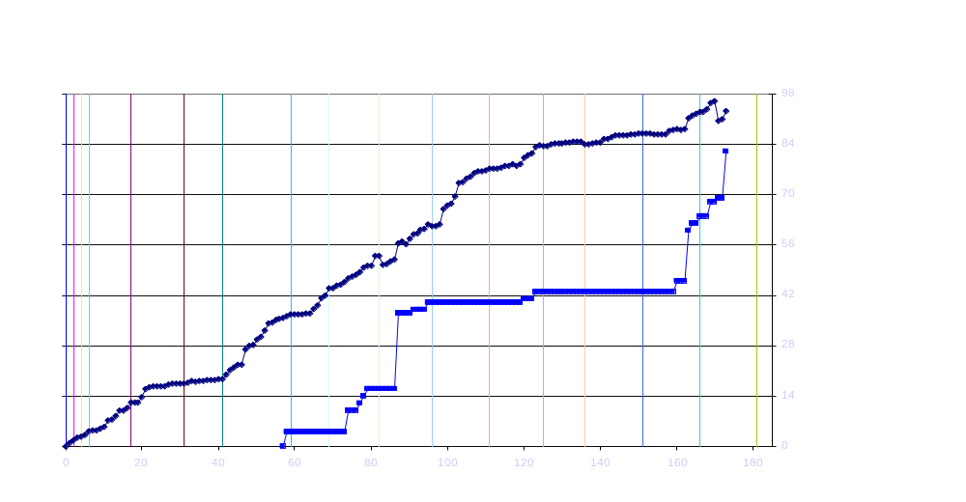
Total Tests & Functional Tests 5/09

Slide 29
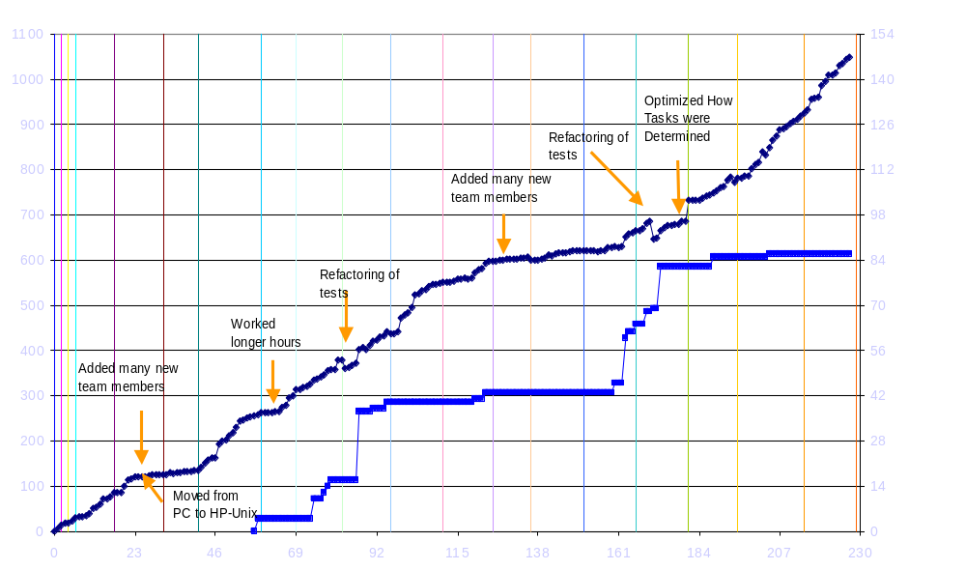
Total Tests & Functional Tests 7/30
Iteration 012 3 4 5 6 7 8 9 10 11 12 13 14 15 16 17 18

Slide 30
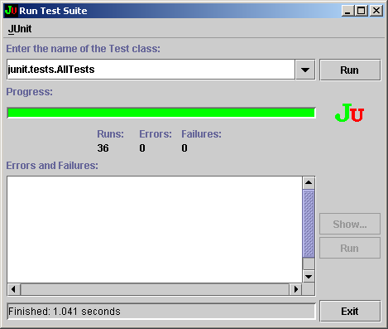
JUnit TestRunner

Slide 31
One Test of an Email Reader
public void testTossHeader()
{
EGroupFile eFile = new EGroupFile(“DigestFile.txt");
eFile.tossHeader( );
String expected = "Message: 1";
String actual = eFile.lastLine( );
assertEquals(expected, actual );
}

Slide 32
Summary
A Better Metaphor
    Software Supply Line Management
XP Core Practices
    12 effective ways to work
The Facts of Pairing
    Lower Defects, More Learning
Scheduling Features
    Well defined process
Measuring Progress
    Done or Not Done

Slide 33
ObjectWind Services
Agile Software Engineering Practices
  Your team, or
  ObjectWind XP Partner
Project Services
  Design Improvement (Refactoring)
  Testing
  Patterns Mentoring
Training with Object Mentor
www.ObjectWind.com

